Slide 1

Introduction to Data Science
Traditional statistical sampling refers to the selection of a limited number of individuals from within the statistical population¹ to estimate the characteristics of the entire population.
1: A set of similar items or events which is of interest for some question or experiment
Notes:
<number>

Slide 2
Introduction to Data Science
General-Purpose Sampling Strategies:
Simple Random
Stratified Random
Density Biased Sampling
Notes:
<number>

Slide 3
Introduction to Data Science
1. Simple Random Sampling
When to use: When the population members are similar to one another on important variables
Advantage: Ensures a high degree of representativeness
Disadvantage: Time consuming and tedious
Notes:
<number>

Slide 4
Introduction to Data Science
2. Stratified Random Sampling (1)
A stratified random sample is a population sample that requires the population to be divided into smaller groups, called 'strata'. Random samples can be taken from each stratum, or group.
Notes:
<number>

Slide 5
Introduction to Data Science
2. Stratified Random Sampling (2)
Example: Suppose we want to study one or more characteristics in a large group of individuals.
If the sample is not homogeneous, the results may provide false insight concerning the larger population.
Instead, we should divide the individuals of our sample into groups (strata) based on a certain feature.
The results will be more accurate, since the statistical analysis is conducted on group level.
Notes:
<number>

Slide 6
Introduction to Data Science
2. Stratified Random Sampling (3)
Sub-categories of stratified random sampling:
Proportionate: the population percentage of each group is taken into account
2) Disproportionate: when the percentage is of no interest.
Notes:
<number>

Slide 7
Introduction to Data Science
2. Stratified Random Sampling (4)
When to use: When the population is heterogeneous and contains several different groups, some of which are related to the topic of the study.
Advantage: Ensures a high degree of representativeness of all the strata or layers in the population.
Disadvantage: Time consuming and tedious
Notes:
<number>

Slide 8
Introduction to Data Science
3. Density Biased Sampling (1)
Data Mining in large data sets often requires a sampling or summarization, so that the data can be processed more efficiently ¹.
Uniform sampling is not suitable because it misses small clusters.
Density Biased Sampling addresses the limitations presented by Uniform Sampling, by producing the desired probability distribution in the sample.
1: R. Palmer, Christopher & Faloutsos, Christos. (2000). Density Biased Sampling: An Improved Method for Data Mining and Clustering. ACM SIGMOD Record. 29. . https://www.researchgate.net/publication/2237140_Density_Biased_Sampling_An_Improved_Method_for_Data_Mining_and_Clustering
Notes:
<number>

Slide 9
Introduction to Data Science
3. Density Biased Sampling (2)
Density Biased Sampling is proposed to probabilistically under-sample dense regions and over-sample light regions. A weighted sample is used to preserve the densities of the original data
The idea is that the probability that a given point will be included in the sample depends on the local density of the data.
Notes:
<number>

Slide 10
Introduction to Data Science
3. Density Biased Sampling (3)
Example 1: Density Biased sampling used in Data Mining by using the density of the data to enhance the speed of general data mining tasks¹ .
Example 2: Density Biased Sampling used in studying pore formation in Biology² .
1: http://ieeexplore.ieee.org/document/1232271/
2: http://pubs.acs.org/doi/abs/10.1021/ct5009153
Notes:
<number>

Slide 11
Introduction to Data Science
Why is sampling relevant to Data Science?
Data mining algorithms may not use all data in the dataset
Mining on part of the data may produce comparable results as on the whole data
Notes:
<number>

Slide 12
Introduction to Data Science
How to apply sampling in Data Science
As part of preprocessing
Easy to implement
Embedding sampling into the algorithm
Hard to implement
May be faster
E.g. adaptive sampling
Notes:
<number>

Slide 13
Introduction to Data Science
Bagging and boosting
Weak learners
Combine them using averaging or max vote
Creates a stronger learner
Notes:
<number>

Slide 14
Introduction to Data Science
Bagging
Create n different training samples using replacements
Train each weak learner on a sample.
Average the results of all the weak learners
Reduces variance and helps to avoid overfitting
Notes:
<number>

Slide 15
Introduction to Data Science
Boosting
Take a sample space
Until no learners left:
Find the current best weak learner
Reduce the weight of the correct classified values and increase it for the values that are classified wrong
The final strong classifier is a combination of the weighted weak learners.
Reduces variance and bias
Notes:
<number>

Slide 16
Representative Sample
What is a Representative Sample?
A representative sample is a small quantity of something that accurately reflects the larger entity. An example is when a small number of people accurately reflect the members of an entire population. In a classroom of 60 students, in which half the students are bachelor student and half are master student, a representative sample might include ten students: five bachelor and five master.
Read more:
Representative Sample http://www.investopedia.com/terms/r/representative-sample.asp#ixzz4sqAwJC9G
Notes:
<number>

Slide 17
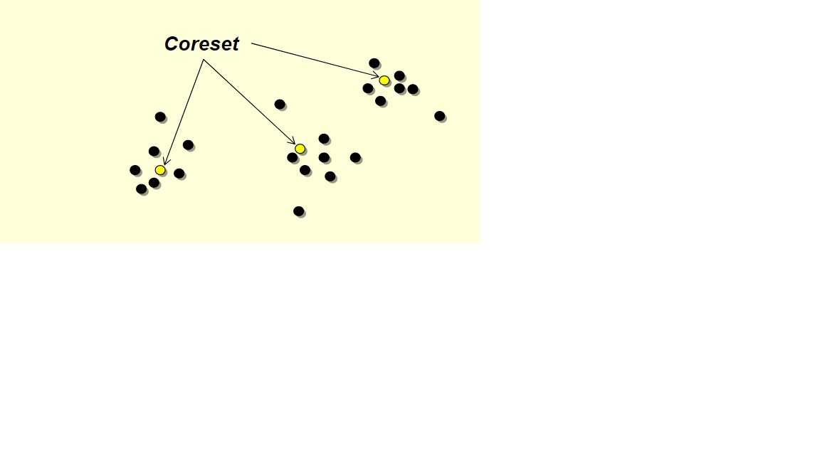
Coresets
What is a Coreset?
A subset of input, such that we can get a good approximation to the original input by
solving the problem directly on the coreset.
Read more:
Bi-Criteria Linear-Time Approximations for Generalized k-Mean/Median/Center”(Danny Feldman, Amos Fiat, Micha Sharir, Danny Segev
Notes:
<number>

Slide 18
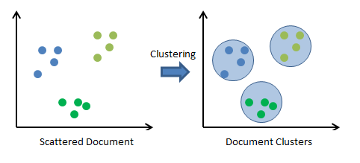
Clustering
Clustering: is the task of dividing the population or data points into a number of groups such that data points in the same groups are more similar to other data points in the same group than those in other groups. In simple words, the aim is to segregate groups with similar traits and assign them into clusters.
Read more:
https://www.analyticsvidhya.com/blog/2016/11/an-introduction-to-clustering-and-different-methods-of-clustering/
Notes:
<number>

Slide 19
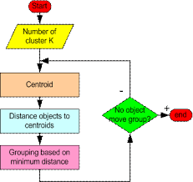
K Means Clustering
K means: is an iterative clustering algorithm that aims to find local maxima in each iteration
Read more:
https://www.analyticsvidhya.com/blog/2016/11/an-introduction-to-clustering-and-different-methods-of-clustering/
Notes:
<number>

Slide 20
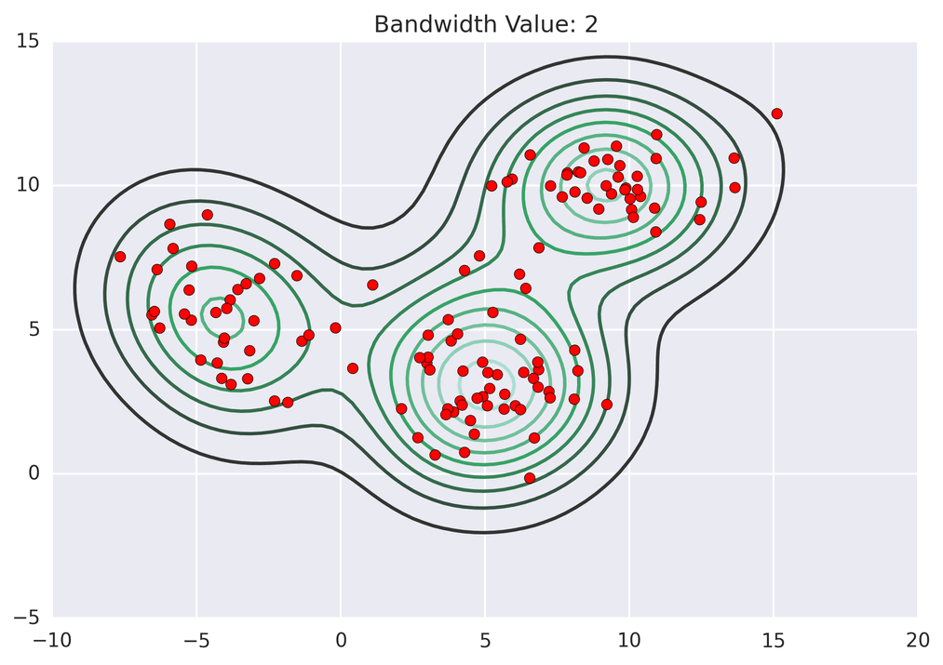
K Means Clustering
Read more:
https://www.analyticsvidhya.com/blog/2016/11/an-introduction-to-clustering-and-different-methods-of-clustering/
Notes:
<number>

Slide 21
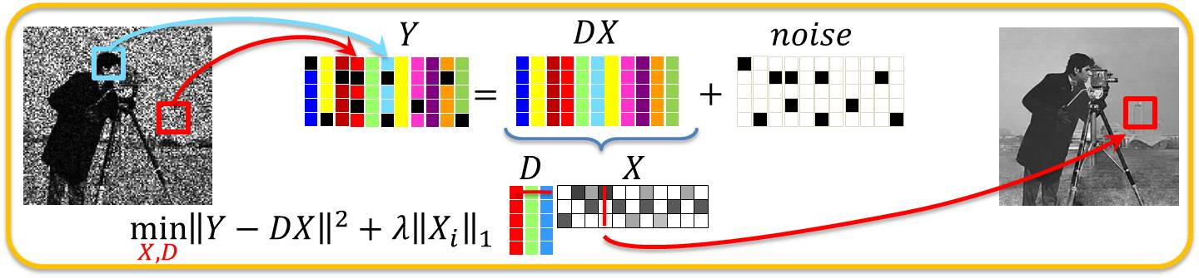
Dictionary Learning
is a representation learning method which aims at finding a sparse representation of the input data (also known as sparse coding) in the form of a linear combination of basic elements as well as those basic elements themselves
Notes:
<number>

Slide 22
Read more:
K-SVD: DESIGN OF DICTIONARIES FOR SPARSE REPRESENTATION
Michal Aharon Michael Elad Alfred BrucKstein
Technionó_Israel Institute Of Technology, Haifa 32000,Israel
https://en.wikipedia.org/wiki/Sparse_dictionary_learning
https://www.analyticsvidhya.com/blog/2016/11/an-introduction-to-clustering-and-different-methods-of-clustering/
Bi-Criteria Linear-Time Approximations for Generalized k-Mean/Median/Center”(Danny Feldman, Amos Fiat, Micha Sharir, Danny Segev
Representative Sample http://www.investopedia.com/terms/r/representative-sample.asp#ixzz4sqAwJC9G
P. K. Agarwal, S.Har-Peled, and K. R. Varadarajan. Geometric approximations via coresets
Learning Big(Image)Data via Coresets for Dictionaries Dan Feldman, Micha Feigin, and NirSo chen
Coresets fork-Means andk-Median Clustering and their Applications∗Sariel Har-Peled†Soham Mazumdar‡November 7, 2003
Notes:
<number>

